Slide 1
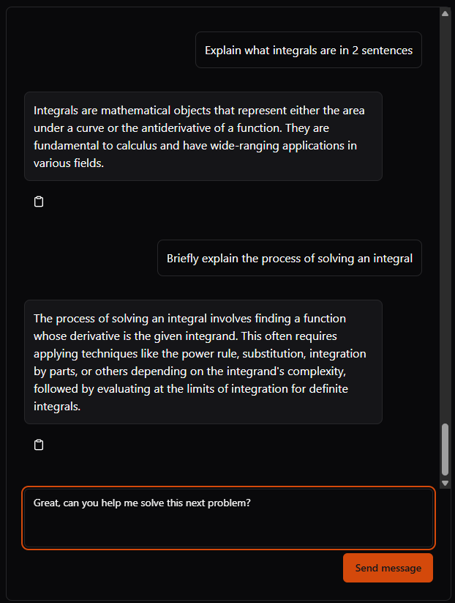
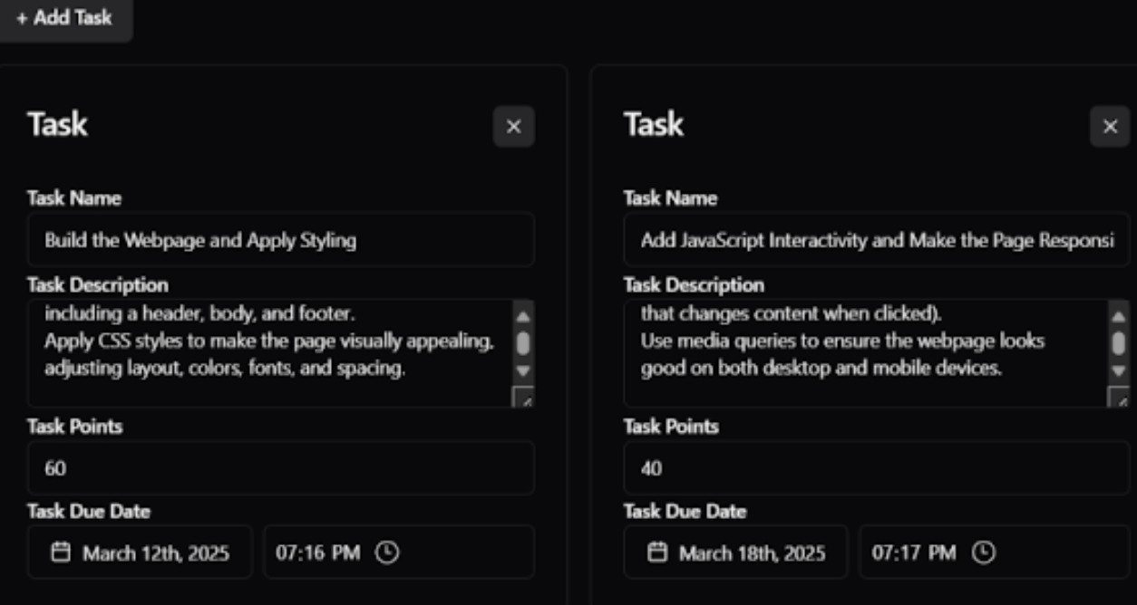




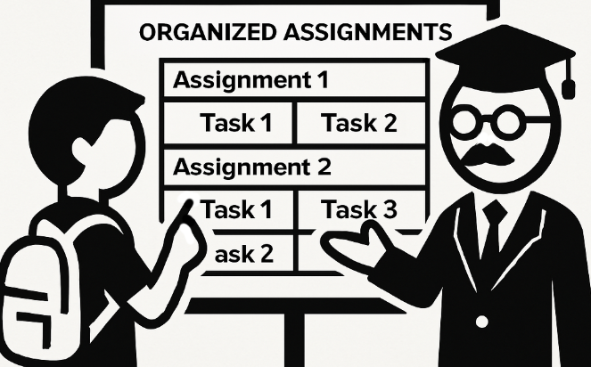
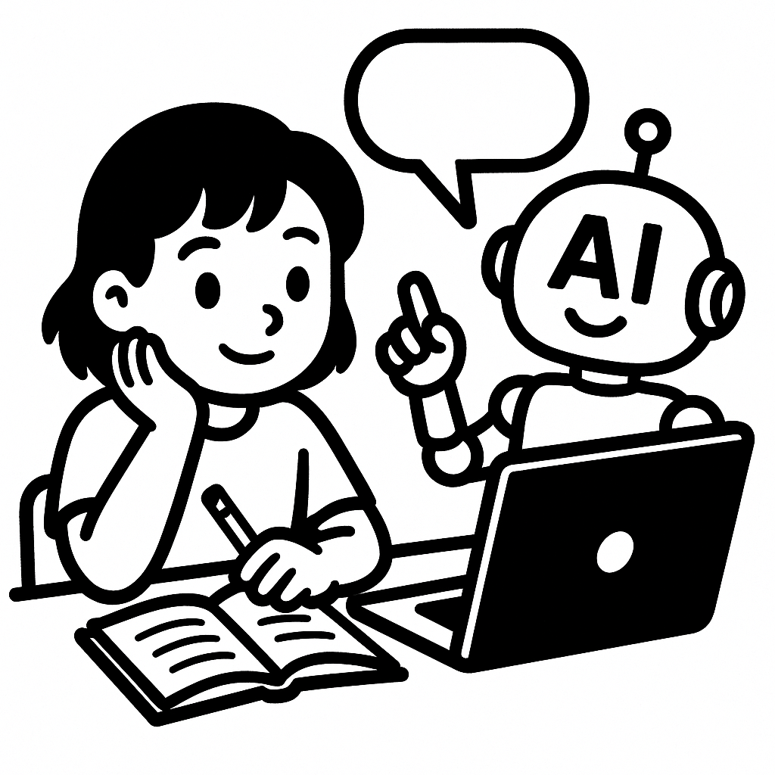

CS.028
BREAKING DOWN TASKS & AI CHATBOTS FOR SCHOOLWORK
EDUCATION PLATFORMS LACK ORGANIZATION AND POSITIVE USES OF AI
ACKNOWLEDGEMENTS
TEAM MEMBERS AND CONTACT INFO
Oliver Zhou: Project Organizer email: zhouo@oregonstate.edu
Collin Kimball: Project Frontend Developer email: kimbacol@oregonstate.edu
Trent Matsumura: Project Backend Developer: email: matsumut@oregonstate.edu
Ethan Lu: Project AI Integration Developer: email: luet@oregonstate.edu
Sai Meenakshisundaram: Project Documentor/Developer email: meenkass@oregonstate.edu
PROJECT PARTNER
Sanjai Tripathi: Project Idea/Mentor work: Oregon State University, College of Business title: Entrepreneurship & Strategy Senior Instructor
A New Learning Management System with Better Organization And Use of Modern AI Technologies
What’s the Problem?
Our Lack of Organized Assignments
Current Learning Management Systems platforms such as Canvas are limited in their ability to effectively support complex learning experiences, and clear assignment structures and organization.
Unregulated Usage of AI in Education
There has been limited exploration into the productive integration of AI Language models such as ChatGPT.
Students are incentivized to use AI chatbots as a shortcut tool for completing assignments which has undermined positive learning outcomes.
What is the Solution?
We need a tool that can organize assignments in more complex structures than existing cookie-cutter assignment builders.
We need AI models to be integrated as productive tools which “guide” students’ learning rather than being a shortcut.
The Ultimate Goal
We hope that educators will have an easier time building assignments that are clear and organized, and that students can learn in a space that uses modern technology in ways that are productive and foster growth.
Figure 1: Splitting Assignments Into Multiple Tasks.
Teachers can create assignments with subcategories which are smaller tasks or progress points students can work on.
Figure 2: Getting Guided Assistance From Chatbots.
Students get guided through their learning via AI Chatbot.
BREAKING DOWN TASKS
METACOGNITIVE AI CHATBOTS
ABOUT US
Oliver Zhou bio: Computer Systems major and enjoys working on cloud applications.
Collin Kimball bio: Experienced in designing full-stack applications .
Trent Matsumura bio: Computer Science major who excels in developing backends and databses
Ethan Lu bio: Artificial Intellegience focus on CS, specializing in AI models
Sai Meenakshisundaram: bio: CS major specializing in systems with experience working on web applications
Task-delineation is the process of breaking down a larger project or assignment into smaller, clearly defined tasks. This ensures that responsibilities are clear, deadlines are more manageable, and work progresses in a more organized and efficient way.
Outcomes from Task-Delineation
Instructors can organize tasks in a structured sequence or hierarchy to guide students through complex assignments.
Each assignment provides student a clear breakdown of tasks, including descriptions, goals, and instructions for each step.
Artificial intelligence chatbots can support student learning by providing instant answers to questions, explaining complex topics in simpler terms, and offering personalized feedback.
Outcomes from AI-Integration
Instructors can efficiently view student progress summaries to assess their assignments.
Students can ask questions about tasks and receive relevant, context-sensitive feedback from the AI chatbot.
Guided learning is appropriately provided to students to help them through complex setups for assignments.

